Slide 1

CUSTOMER CHURN ANALYSIS

Slide 2
Meet Our Team
LE.Dharma Teja Goud
BATCH – 442
BACKGROUND – B.TECH(CSE(DS))
T.Sandeep Reddy
BATCH – 442
BACKGROUND – B.TECH(CSE(DS))

Slide 3
Project introduction
This Power BI project focuses on analyzing customer churn — that is, understanding which customers are leaving a telecom company and why.
The main goal is to identify key factors that drive churn, analyze customer behaviors, and find actionable insights that can help reduce churn and increase customer retention.
Business Goal:
“To help the company understand customer behavior better and design
effective retention strategies to reduce churn and improve long term-
profitability.”

Slide 4
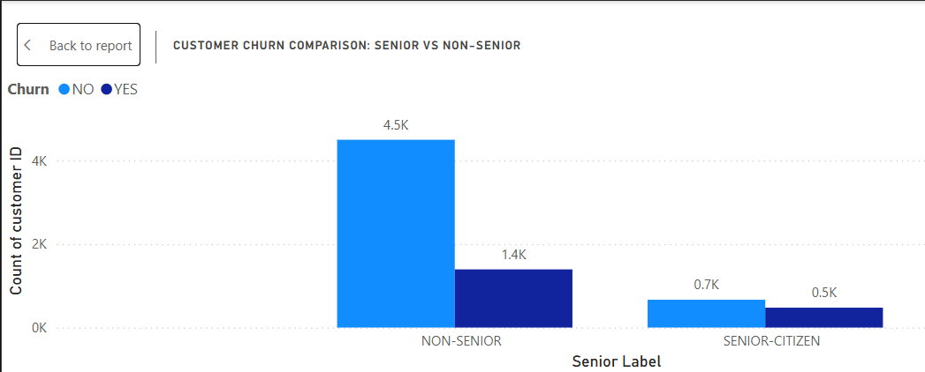
Churn Rate by Senior Citizen
Visual Placeholder:
Clustered Column Chart showing churn by Senior Citizen (Yes/No)
Rows: Senior Label
Values: Global(total) Churn Rate
Interpretation:
Senior citizens show higher churn — retention offers may help reduce churn.
Global Churn Rate:
Senior-Citizen : 0.7k
Non-Senior : 4.5k

Slide 5
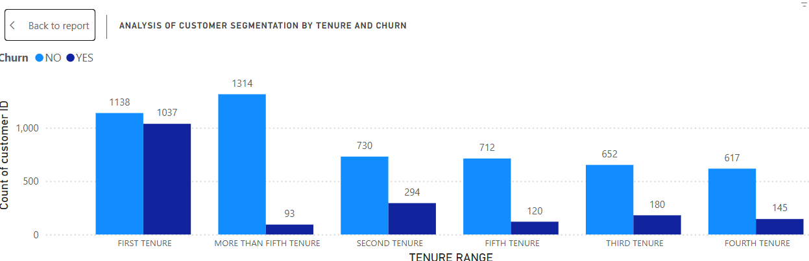
Churn Distribution by Tenure Range
Visual Placeholder:
Clustered Column Chart with various tenure ranges.
Interpretation:
Customers who are new (0–12 months tenure) have the highest churn rate.
As tenure increases, the churn rate drops significantly.
Long-term customers (48+ months) are much more loyal.
This creates a clear downward trend — churn decreases as tenure increases.

Slide 6
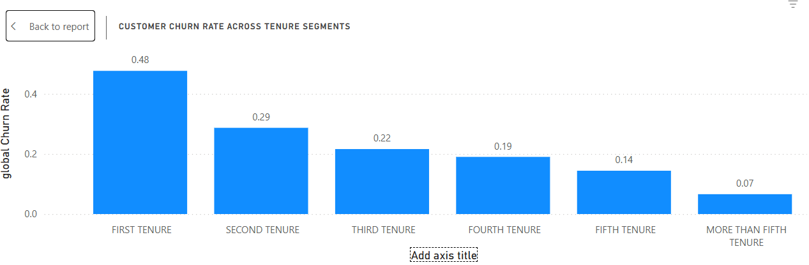
Customer Churn Rate Across Tenure Segments
Visual Placeholder:
Clustered Column Chart with various tenure ranges.
Interpretation:
The company should focus retention efforts on new customers, as they are the most at risk of churning.
This could include onboarding support, early engagement, or introductory offers to improve stickiness.

Slide 7
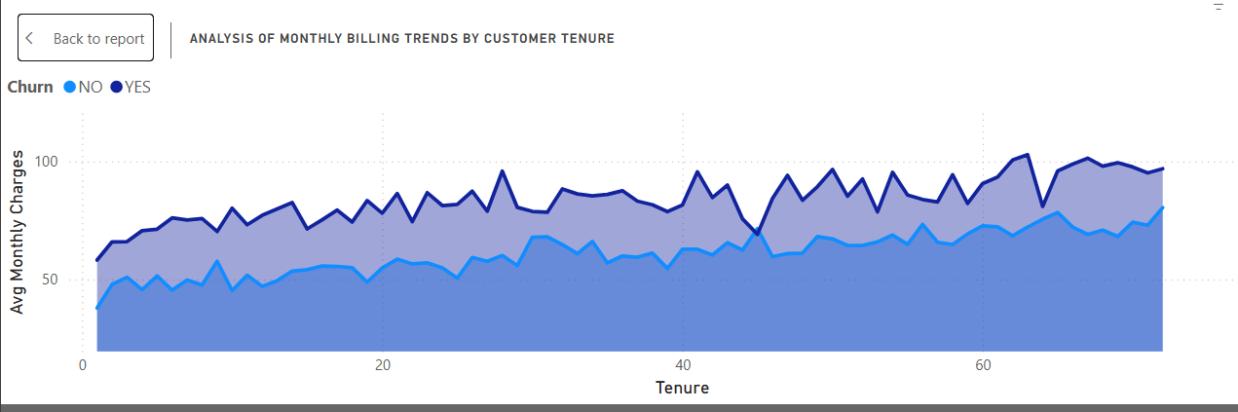
Analysis of Monthly Billing Trends by Customer Tenure
Visual Placeholder:
Line Chart with various tenure ranges or tenure months.
Interpretation:
Some mid-tenure groups (e.g., 13–24 or 25–36 months) may have slightly higher average charges than the earliest tenure group, but the trend is not strictly upward.
There isn’t a strong correlation between tenure and monthly charges.
While some new customers pay less and mid-tenure customers slightly more, higher tenure does not necessarily mean higher monthly charges.

Slide 8
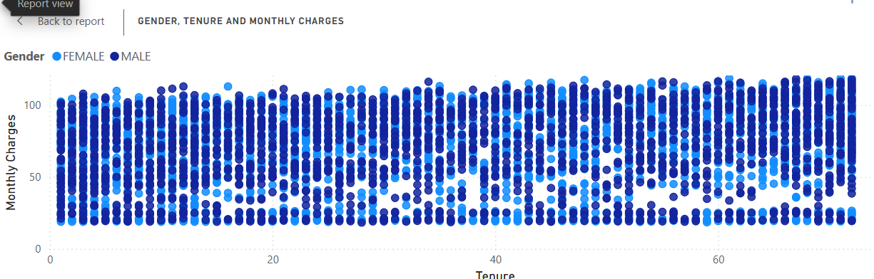
Gender, Tenure and Monthly Charges
Visual Placeholder:
Scatter Chart with various tenure ranges or tenure months and monthly charges segmented among gender.
Interpretation:
No strong correlation between tenure and monthly charges is observed for either gender.
Both male and female customers show a wide spread of monthly charges across all tenure segments.
Some high-paying customers exist in early tenure segments, suggesting that higher charges may or may not prevent early churn.
The distribution is similar for both genders, with no significant difference in average charges or tenure patterns between males and females.

Slide 9
key customer metrics
Total Customers: Shows the overall number of customers, dynamically updating when filters for gender or contract type are applied.
Churned Customers: Displays the count of customers who have churned, reflecting the selected segment.
Global Churn Rate: Updates according to the selected gender or contract type, showing which segments are more prone to churn. For example:
Month-to-month contracts typically show higher churn rates.
Churn for male vs female is similar, with slight variations depending on contract type.
Avg. Monthly Charges: Varies across filtered segments; some contract types (like two-year contracts) may show higher average charges.
Avg. Tenure: Helps identify which segments are more loyal; longer-term contracts usually have higher average tenure.

Slide 10
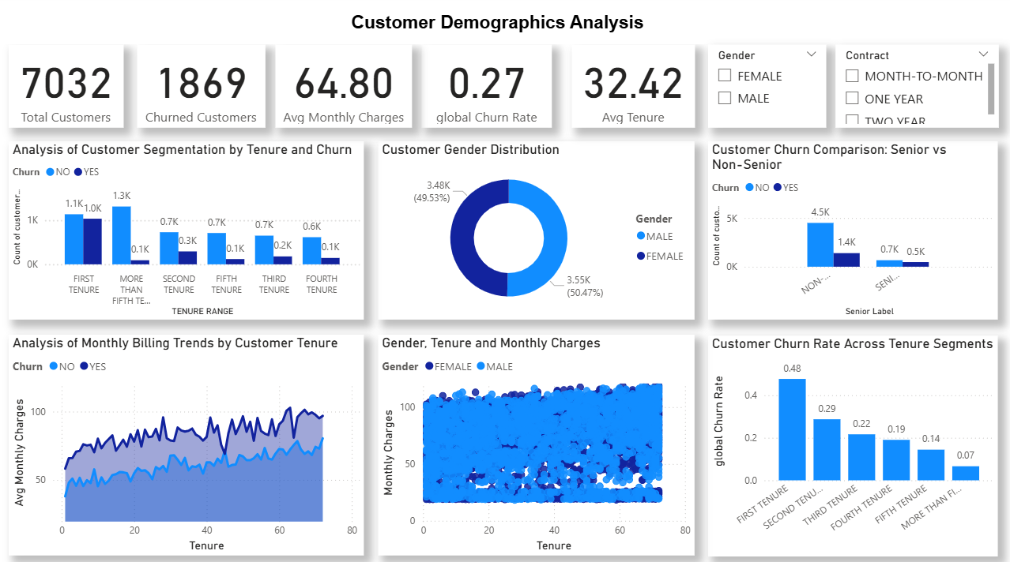

Slide 11
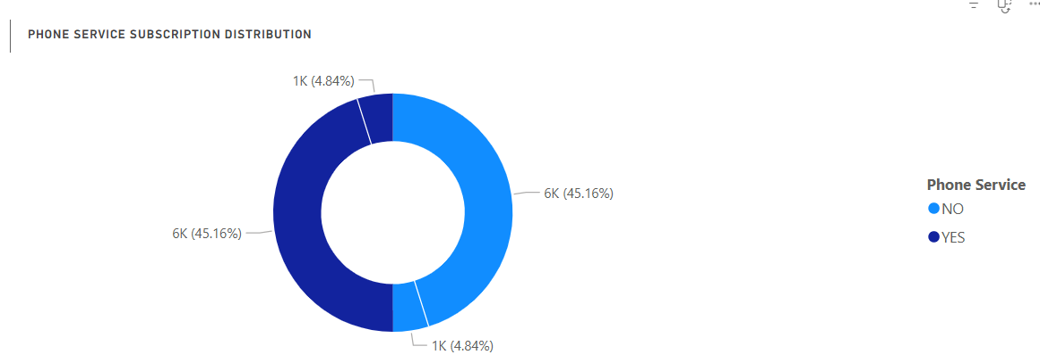
Service Subscription Analysis
Visual Placeholder:
Donut Chart showing Phone service distribution with subscription level.
Interpretation:
This segmentation helps us compare churn behavior and revenue between customers with and without phone service.
Most customers have an active phone service subscription, while a smaller segment does not, allowing us to analyze churn and revenue differences between these groups.

Slide 12
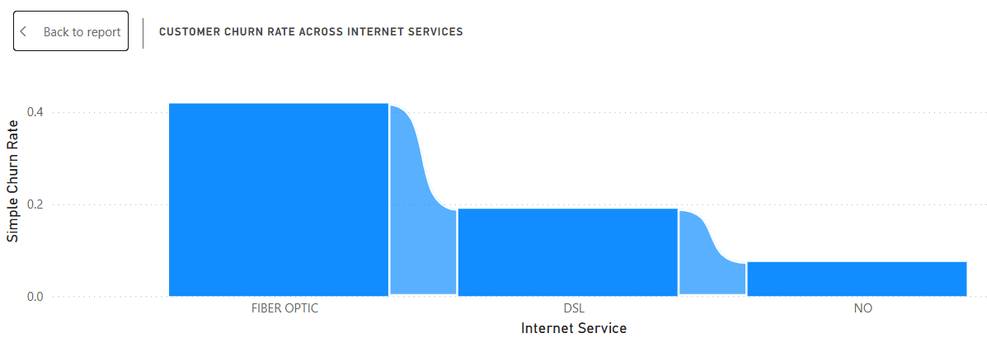
Customer Churn Rate Across Internet Services
Visual Placeholder:
Stacked Column Chart showing churn rate by internet service.
Interpretation:
Fiber Optic customers have the highest churn rate, indicating they are more likely to leave compared to other internet service types.
DSL customers show a moderate churn rate, lower than Fiber Optic but higher than those without internet.
Customers with No Internet service have the lowest churn rate, suggesting they are more stable in terms of retention.

Slide 13
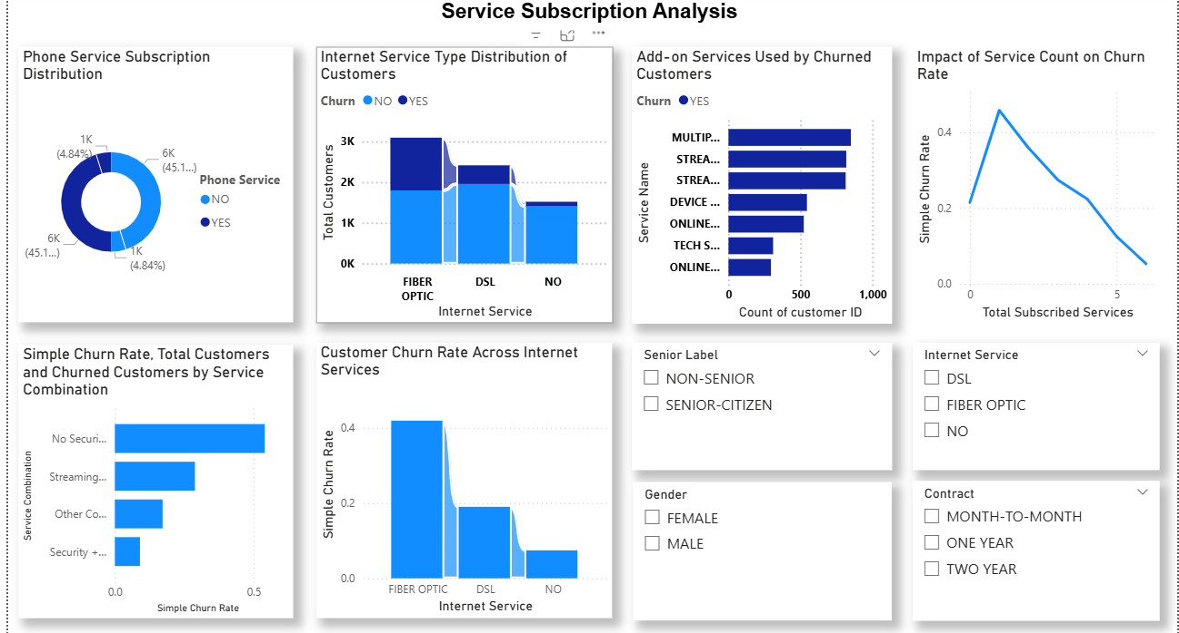

Slide 14
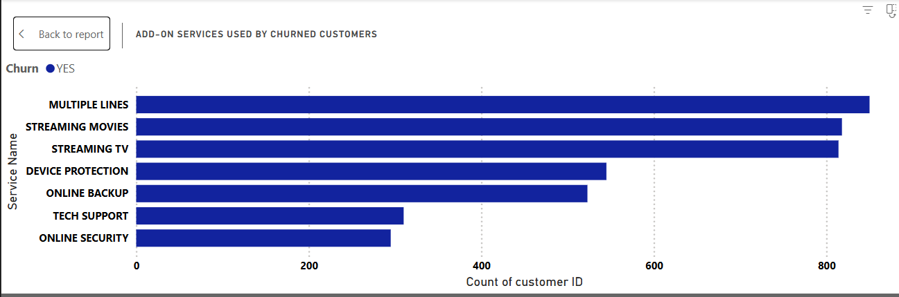
Add-on Services Used by Churned Customers
Visual Placeholder:
Clustered column Chart showing churned customers add on services.
Interpretation:
Churned customers are more likely to have fewer add-on services.
Among the add-ons, services like Streaming TV and Streaming Movies appear more common among churned customers, while Tech Support and Online Security are less common, suggesting these may help retain customers.

Slide 15
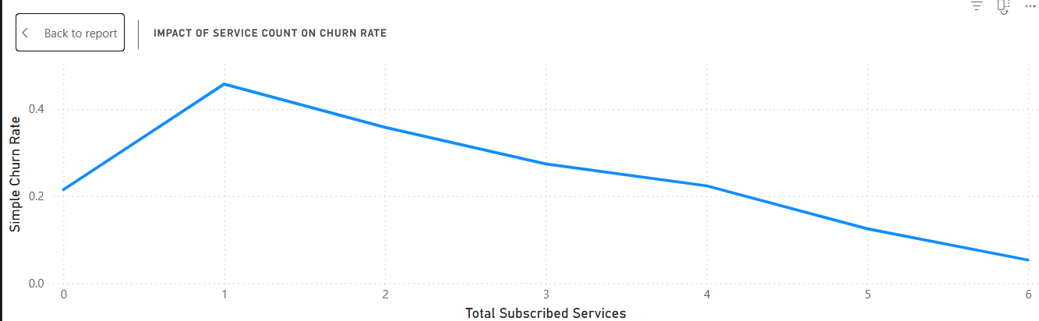
Service Count vs Churn: Customer Breakdown
Visual Placeholder:
100% stacked column Chart showing churned customers based on services.
Interpretation:
Customers with fewer subscribed services tend to have a higher likelihood of churn.
Conversely, customers with multiple services bundled together show a lower churn rate, indicating that having more subscriptions increases customer stickiness.
This pattern is consistent across both core services (Phone, Internet) and add-on services (Streaming, Tech Support, etc.).

Slide 16
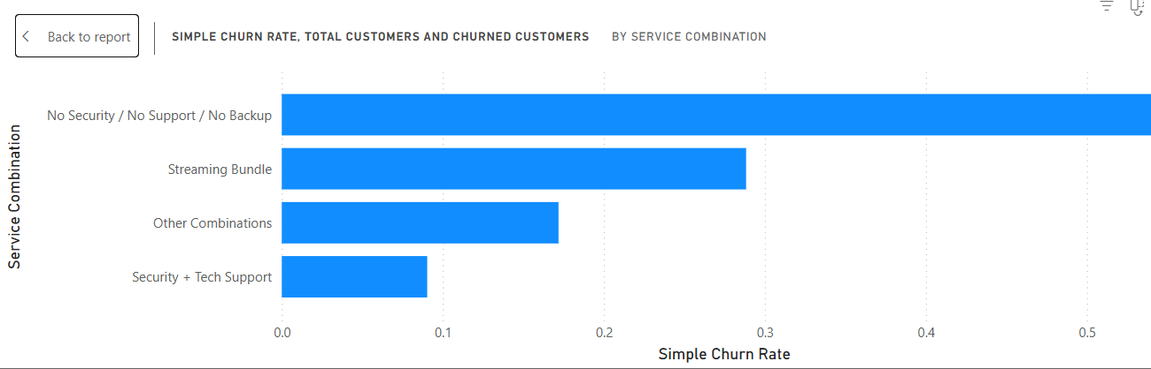
Churn Rate -Top 15 Service Combination.
Visual Placeholder:
Clustered bar Chart showing churned customers Associated with multiple services.
Interpretation:
Customers with multiple services bundled together (e.g., Phone + Internet + Add-Ons) tend to have lower churn rates, indicating that service combinations increase loyalty.
Customers with only basic services, particularly Fiber Internet without add-ons, are most likely to churn, while bundled service combinations are linked to lower churn.

Slide 17
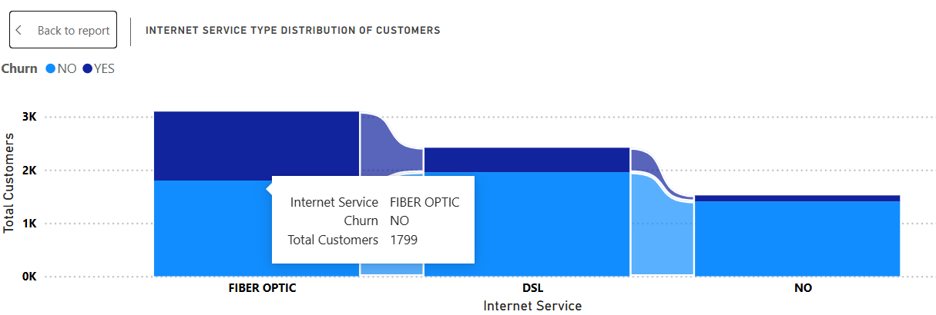
Internet Service-Customers & churn
Visual Placeholder:
Line & clustered column chart used for presenting the internet services by customers and their churn rate.
Interpretation:
Number of Customers by Internet Service:
Fiber Optic: Largest segment of internet users.
DSL: Smaller segment compared to Fiber.
No Internet: Smallest segment.
Churn Rate by Internet Service (Simple Churn Rate):
Fiber Optic: Highest churn rate among all segments.
DSL: Moderate churn rate.
No Internet: Lowest churn rate.

Slide 18
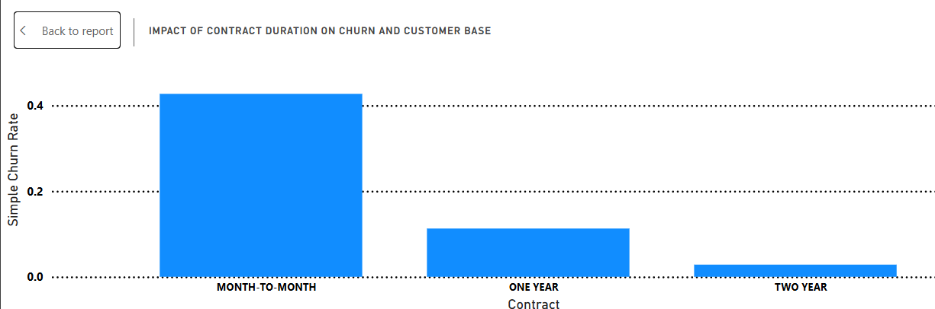
Impact of Contract Duration on Churn and Customer Base
Visual Placeholder:
Clustered column chart for churn rate associated with contract type.
Interpretation:
Month-to-Month contracts show the highest churn rate — these customers are much more likely to leave since they aren’t tied to a long-term agreement.
One-Year contracts have a moderate churn rate, lower than month-to-month but still notable.
Two-Year contracts show the lowest churn rate, indicating that long-term commitments lead to greater customer loyalty and stability.

Slide 19
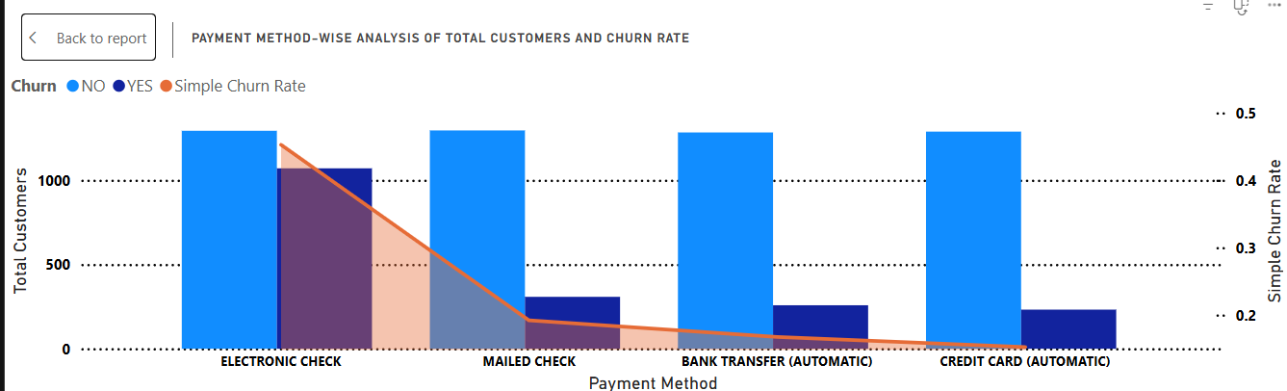
Payment Method-wise Analysis of Total Customers and Churn Rate
Visual Placeholder:
Line and clustered column chart for representing the churn rate by payment method.
Interpretation:
Electronic Check customers have the highest churn rate, indicating they are more likely to leave compared to users of other payment methods.
Credit Card (automatic) and Bank Transfer (automatic) customers show lower churn rates, suggesting that automatic payments improve retention.
Mailed Check users have a moderate churn rate, positioned between electronic check and auto-payment customers.

Slide 20
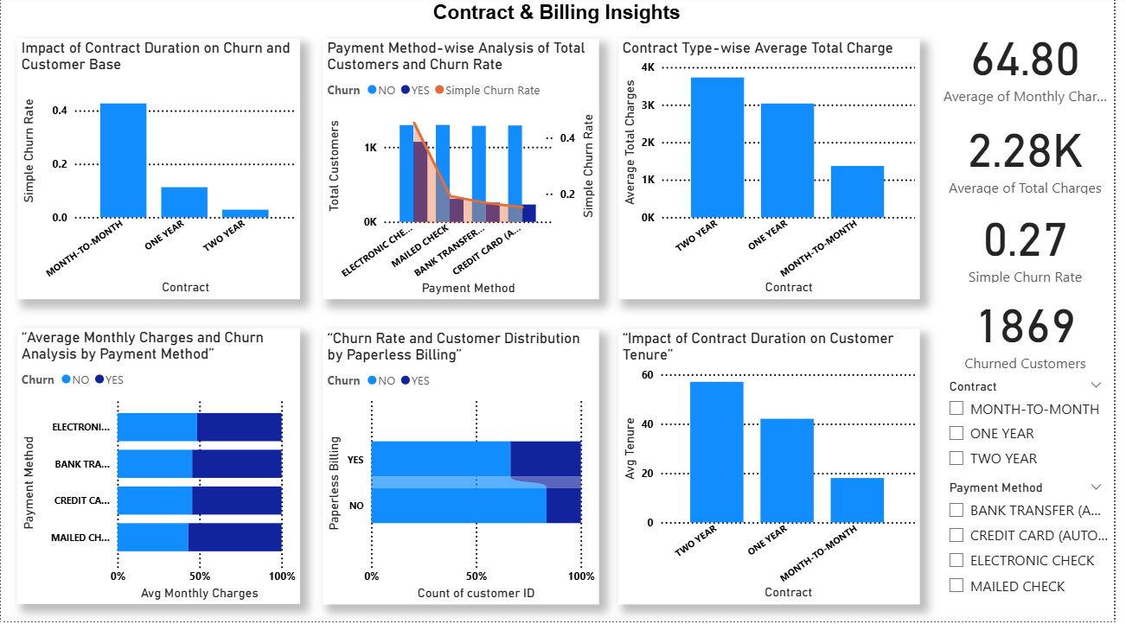

Slide 21
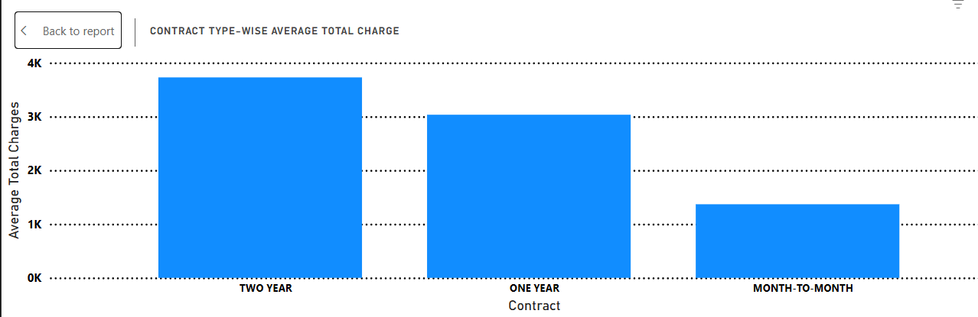
Contract Type-wise Average Total Charge
Visual Placeholder:
Clustered column chart Average total charges associated with contract type.
Interpretation:
Two-Year contract customers have the highest average total charges, which makes sense because they’ve stayed longer and paid over more months.
One-Year contract customers show moderate total charges, reflecting their medium-term engagement.
Month-to-Month customers have the lowest average total charges, since they tend to churn early and contribute less revenue overall.

Slide 22
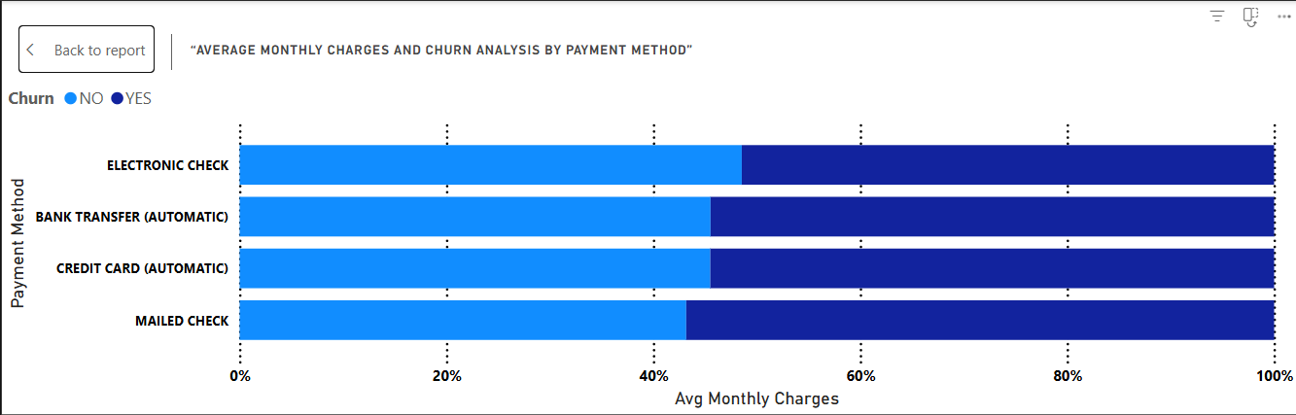
Average Monthly Charges and Churn Analysis by Payment Method
Visual Placeholder:
100% stacked bar chart monthly charges associated with payment method.
Interpretation:
Electronic Check users often show slightly higher average monthly charges, possibly due to choosing flexible, no-contract plans that cost more per month.
Automatic payment users (Credit Card and Bank Transfer) tend to have moderate or slightly lower monthly charges, suggesting they are on longer-term plans with discounted rates.
Mailed Check users generally fall in the mid-range of monthly charges.

Slide 23
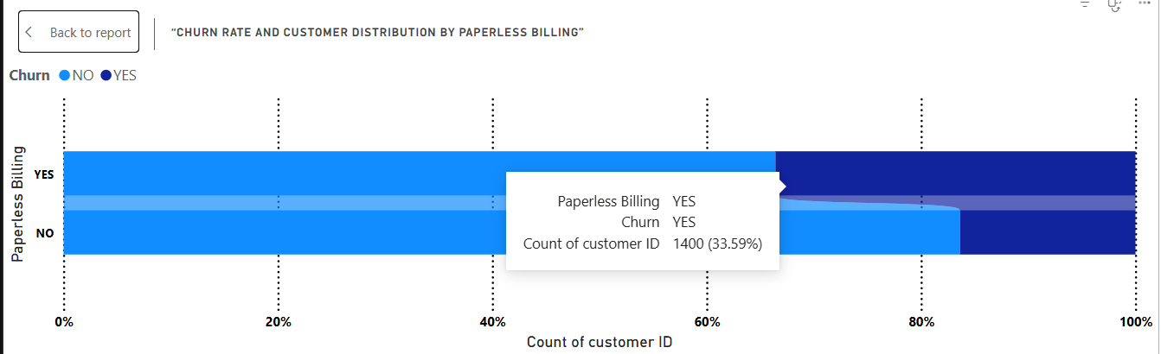
Churn Rate and Customer Distribution by Paperless Billing
Visual Placeholder:
100% stacked bar chart for representing relationship between paperless billing regarding churn
Interpretation:
Customers with Paperless Billing enabled show a higher churn rate compared to those who receive paper bills.
This suggests that paperless billing customers — often associated with month-to-month or online-based payment setups — may be less committed or more price-sensitive.
Customers with non-paperless billing (paper bills) tend to stay longer, possibly due to traditional, long-term contracts.

Slide 24
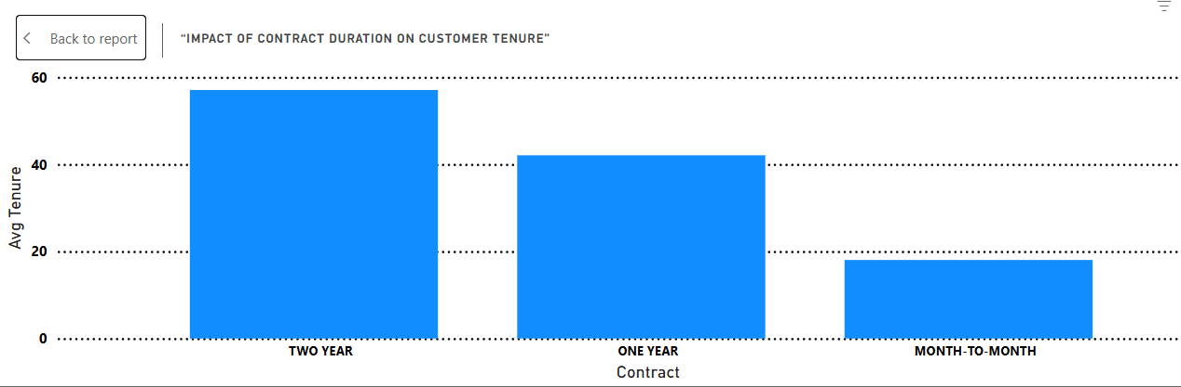
Impact of Contract Duration on Customer Tenure
Visual Placeholder:
Clustered column chart for representing contract period with average tenure using different slicers.
Interpretation:
Month-to-Month contract customers mostly fall in the lower tenure range — they tend to leave early, with many having less than a year of service.
One-Year contract customers show a more balanced tenure distribution, with many staying between 12–24 months.
Two-Year contract customers have the highest tenures overall, with most staying well beyond 24 months, indicating stronger loyalty and satisfaction.

Slide 25
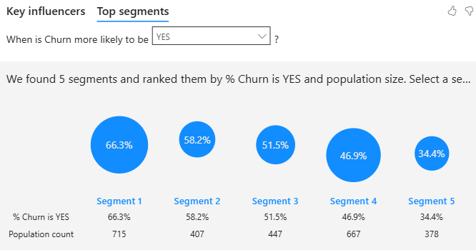
Factors Influencing Customer Churn
Visual Placeholder:
Key influencers was used based on key drivers of churn
Interpretation:
Contract Type – Customers on month-to-month contracts have the highest churn risk.
Tenure – Customers with shorter tenure are significantly more likely to churn.
Monthly Charges – Higher monthly charges are linked to higher churn, especially among cost-sensitive segments.
Internet Service Type – Fiber optic users show higher churn than DSL or non-internet customers.
Payment Method – Electronic check users have higher churn, possibly due to lower commitment or flexibility of cancellation.

Slide 26
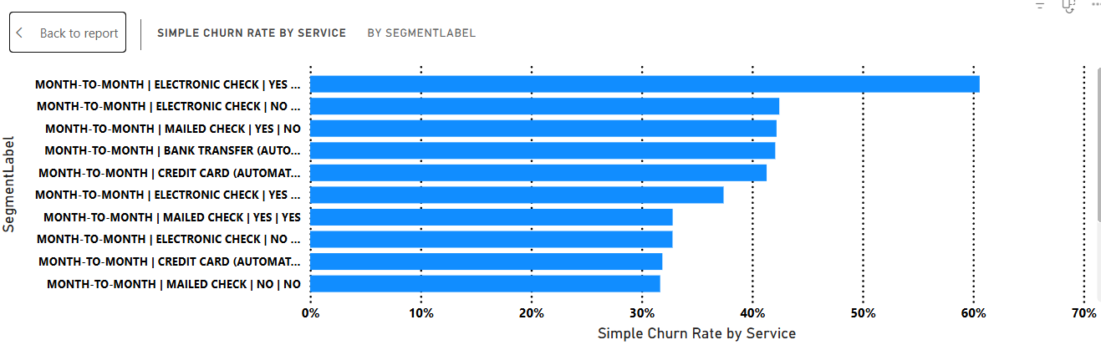
High-Risk Customer Segments for Churn
Visual Placeholder:
Clustered bar chart was used based on key segment drivers of churn prediction.
Interpretation:
Month-to-Month contract customers – show the highest predicted churn probability, as they can leave at any time.
High Monthly Charge customers – those paying above-average charges are more prone to churn, often due to price dissatisfaction.
Short Tenure customers – new customers (especially 0–12 months) churn more frequently.
Fiber Optic users – show a higher churn likelihood compared to DSL or non-internet customers.
Electronic Check payers – churn rate is notably higher among this payment group.
Senior Citizens – slightly higher churn risk than younger customers.

Slide 27
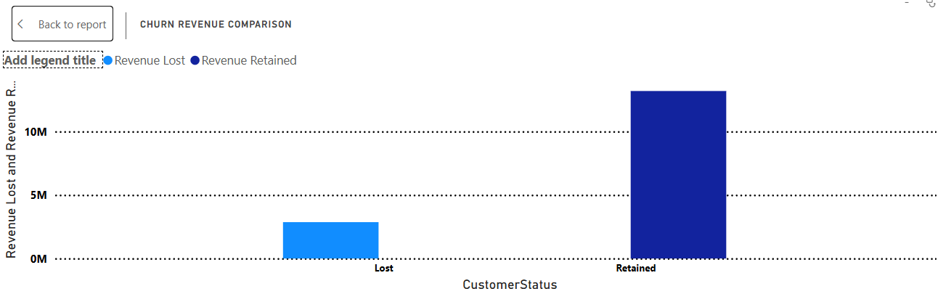
Churn Revenue Comparison
Visual Placeholder:
Clustered column chart was used for revenue lost and retained.
Interpretation:
A significant portion of revenue comes from retained customers, which is expected since most customers do not churn.
However, the revenue lost from churned customers is non-negligible, highlighting the need to focus on high-value customers at risk of churning.

Slide 28
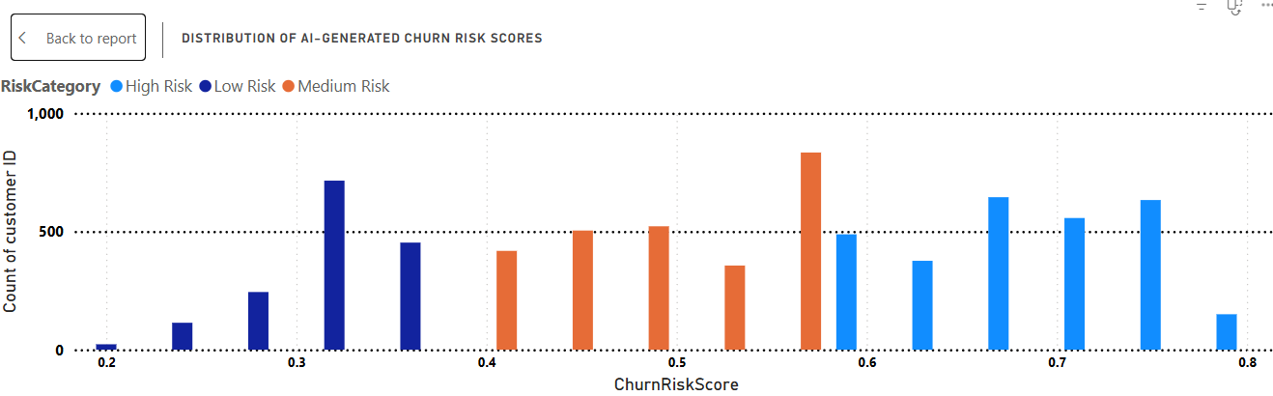
Distribution of AI-Generated Churn Risk Scores
Visual Placeholder:
Clustered column chart was used for churn predictive analysis risk score for various customer id.
Interpretation:
This visual shows the churn risk distribution across our customer base, as predicted by our AI-generated risk score.
We can see that most customers are at low churn risk, which is positive.
However, a notable portion falls under medium and high risk — these are the customers who need focused retention actions.
Targeting these high-risk segments can significantly reduce overall churn

Slide 29
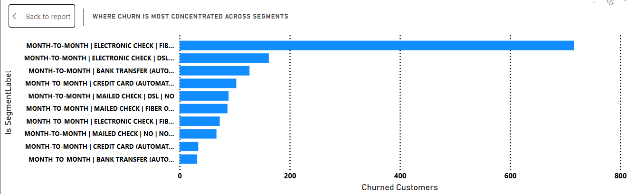
Churn concentration across segments
Visual Placeholder:
Tree map was used for churn concentration across segments.
Interpretation:
1. Month-to-month contract customers show the highest churn concentration, indicating short-term contracts are more likely to leave.
2. Short-tenure customers (tenure ≤ 12 months) contribute disproportionately to churn, highlighting early-stage retention risk.
3. Service combinations like no internet service or multiple add-ons can show higher churn in the visualization, suggesting that certain product bundles are linked to churn.
4. Payment methods also influence churn: e.g., customers using electronic checks often have higher churn rates than those on automatic payments.
5. Segments with paperless billing may show slightly higher churn, but this effect is secondary compared to contract type and tenure.

Slide 30
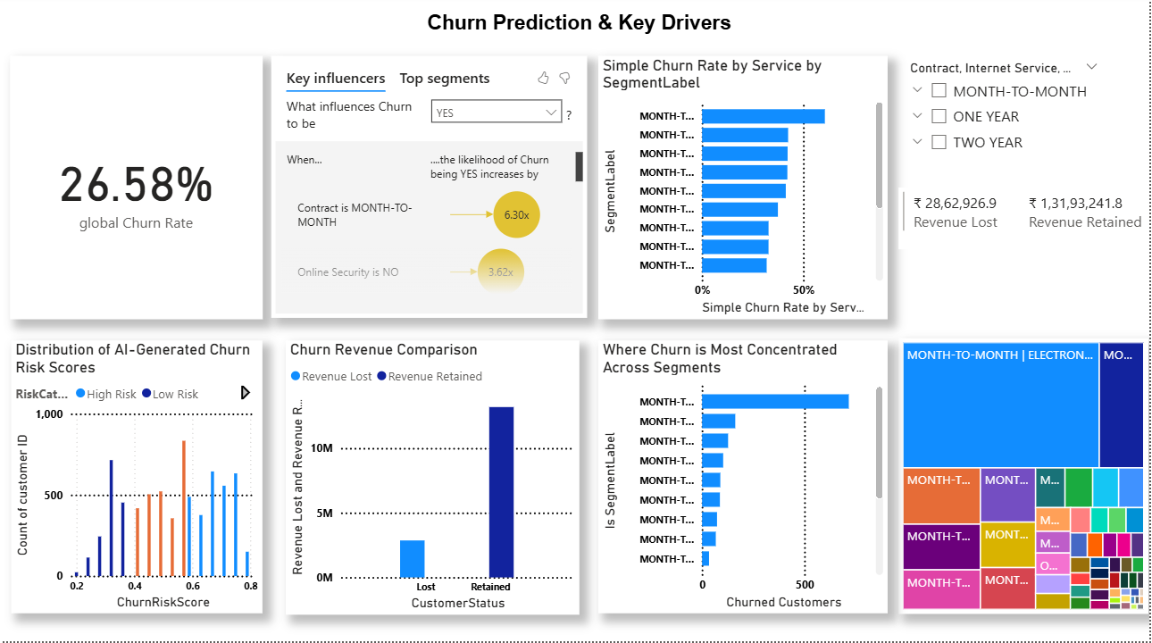

Slide 31
Overall Analysis
CATEGORY | Key Observations | Business Takeway
Tenure | Short-tenure customers churn most | Focus on first-year experience
Contract | Month-to-month = highest churn | Promote annual/biannual contracts
Internet Service | Fiber optic = high churn | Address service quality & pricing
Support | No tech support = high churn | Offer free/discounted support packages
Payment & Revenue | Electronic check = high churn Retained customers = high total charges | Encourage credit card/auto-pay & Retention = profitability

Slide 32
Business recommendations
After analyzing all visuals and metrics, it’s clear that customer churn is primarily driven by contract length, technical support availability, and payment experience, not demographics.
By focusing on early engagement, loyalty programs, and service improvements, the company can significantly reduce churn and protect revenue.
1. Focus on early retention: Target customers in their first 12 months with welcome offers and engagement campaigns.
2. Encourage long-term contracts: Provide discounts or benefits for switching from month-to-month to yearly contracts.
3. Improve service experience: Address dissatisfaction with fiber optic services and support quality.
4. Optimize payment systems: Promote convenient payment methods and discourage electronic check usage.
5. Use churn risk insights: Prioritize outreach to high-risk customers for retention offers.

Slide 33

Thank You

